Slide 1

ELECTRONIC HEALTH RECORDS USING
BLOCKCHAIN
Sankalp Chordia (CSD-18)
Pr no. 12010145

Slide 2
01
04
Existing problems in health care
Objectives
02
05
Results
What is blockchain and what are smart contracts?
03
06
Problem statement
Future Scope and Conclusion

Slide 3
01
Existing problems in health care

Slide 4
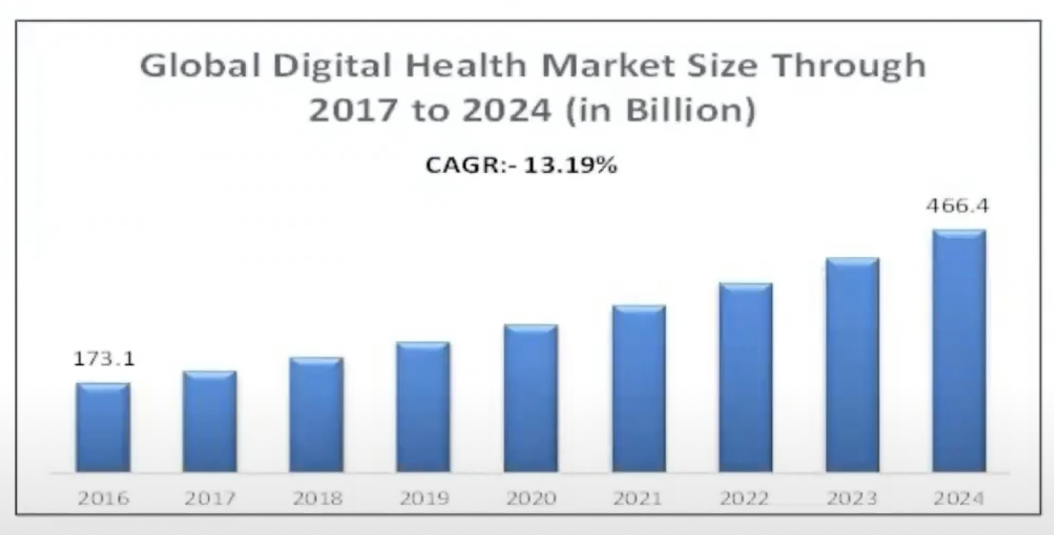
Why are medical records important ?
Global market for health records are growing at a rapid pace
Medical data needs to be improved to meet this demand

Slide 5
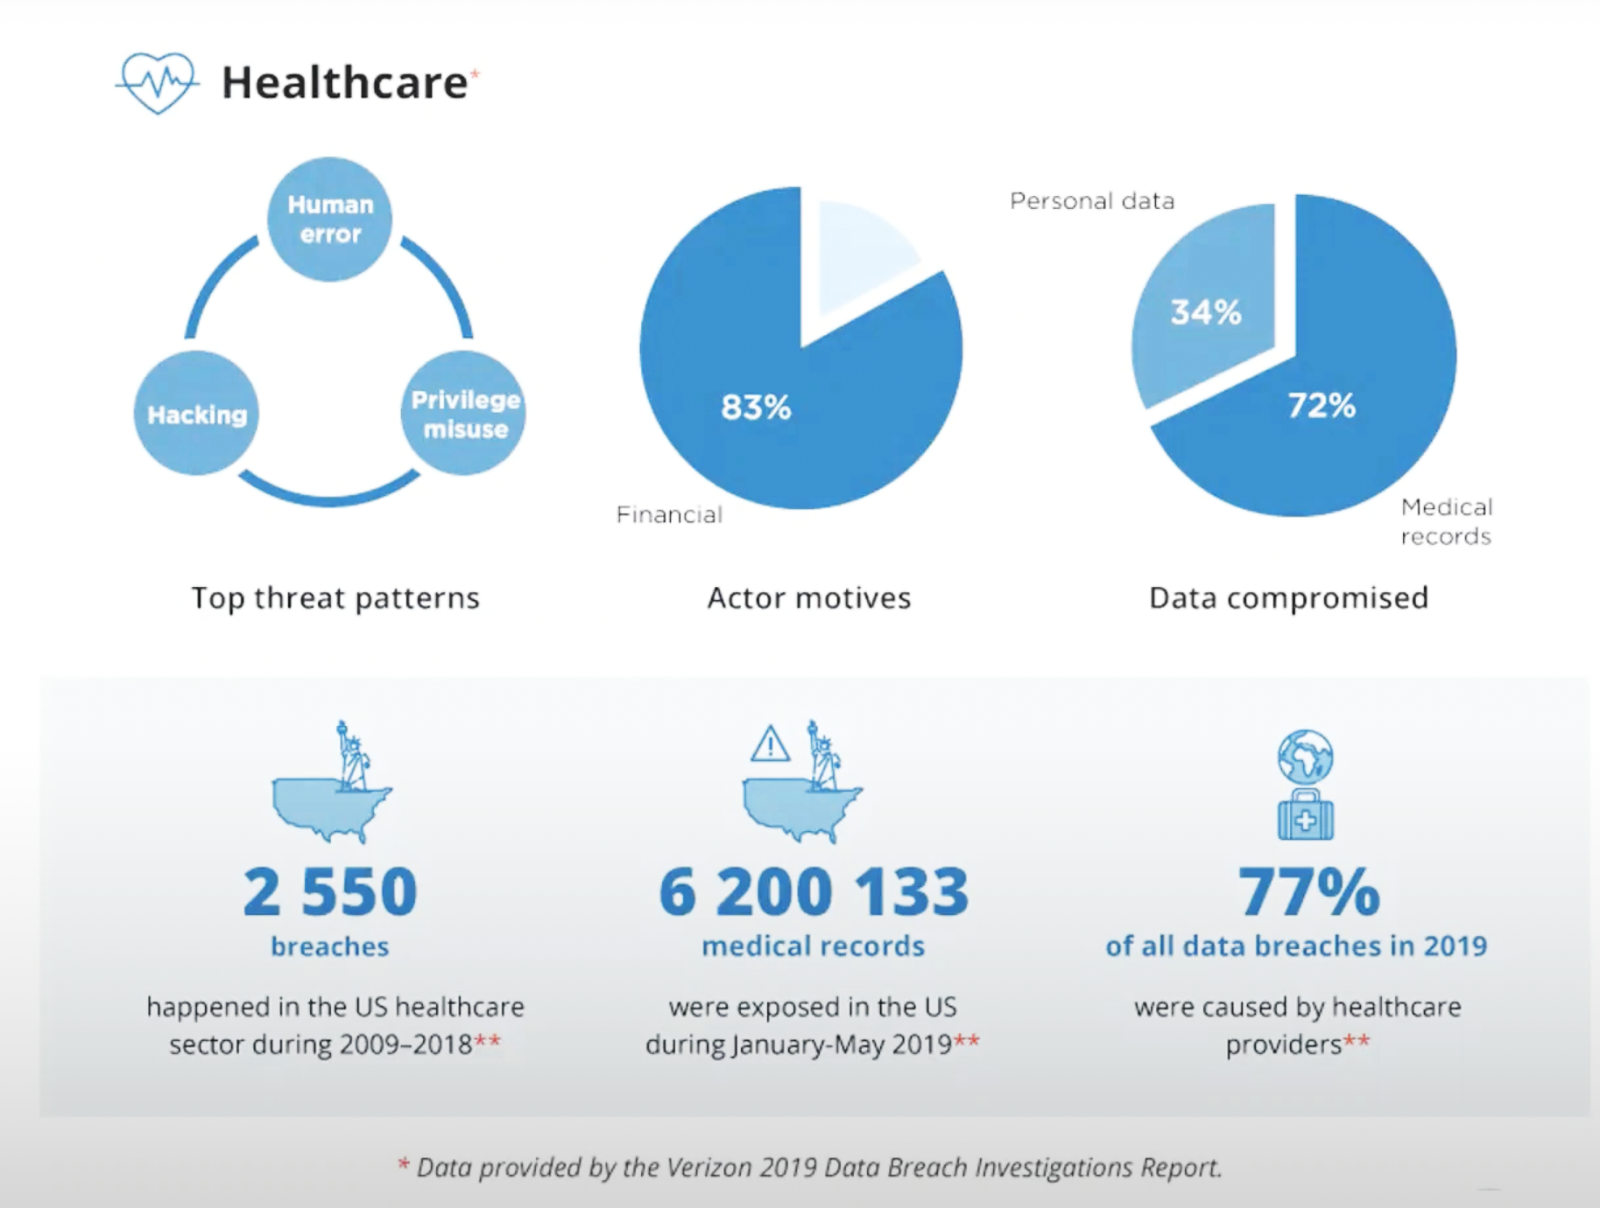
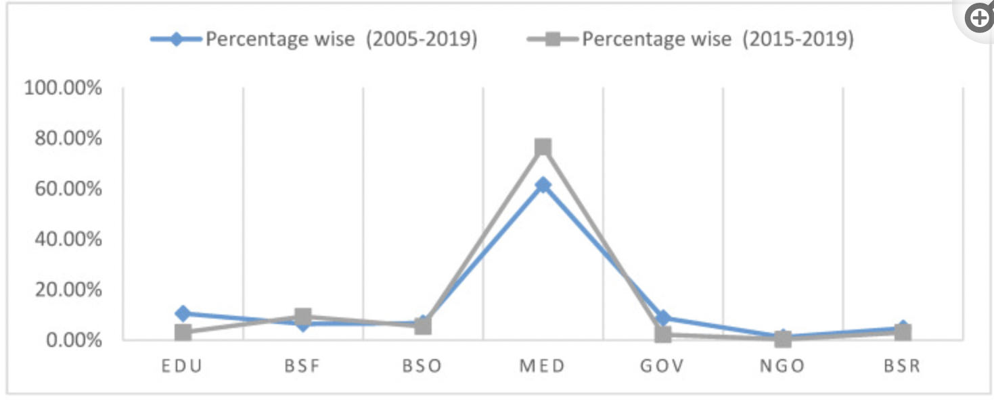
Why are medical records important ?
Total medical record hacks

Slide 6
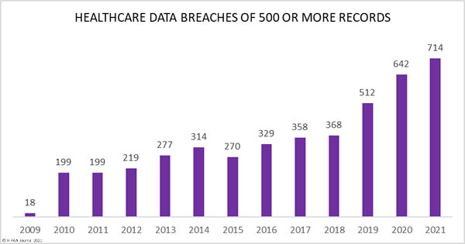
Why are medical records important ?
Trend in data breach of healthcare data

Slide 7
PROBLEM VS. SOLUTION
Problem
Solution
Lack of a proper and secure electronic health record system
Electronic health records using blockchain

Slide 8
02
BLOCKCHAIN AND SMART CONTRACTS

Slide 9
Why Blockchain ? What’s so special about blockchain ?
Blockchain
Can record information about cryptocurrency transactions,NFT ownership or DeFi smart contracts
Is a distributed ledger that can store any type of data
Decentralised where data is stored on multiple nodes.
All nodes can directly communicate with each other and store a copy of blockchain

Slide 10
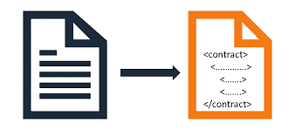
What are Smart Contracts ?
Smart Contracts
Programs stored on blockchain that are executed when certain predetermined conditions are met
Used to automate the execution of an agreement so that all the participants can be immediately certain about the outcome.

Slide 11
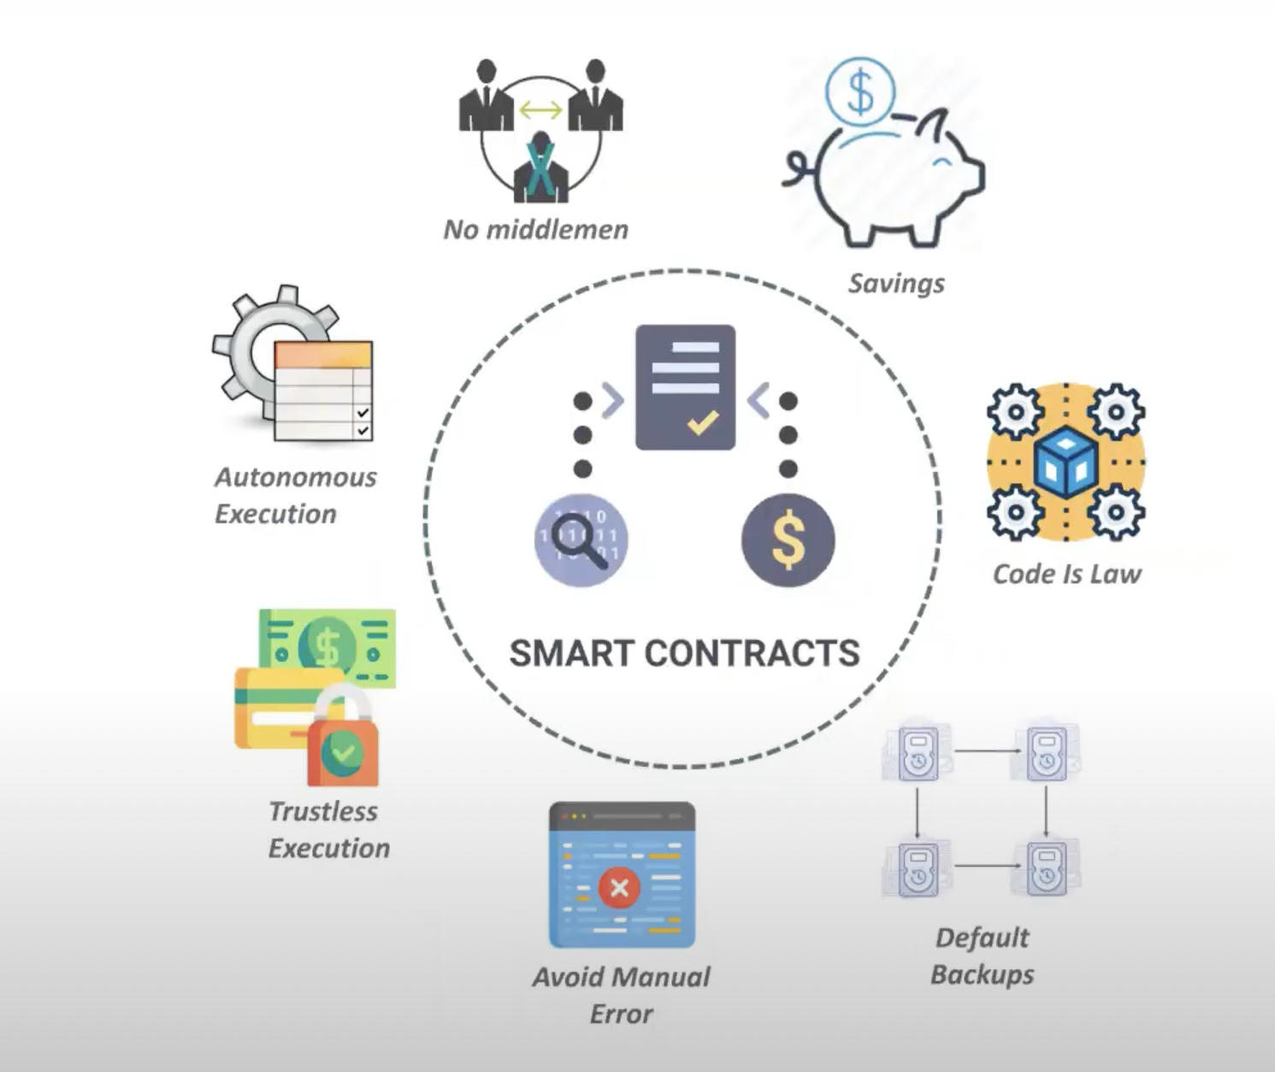
Benefits of Smart contracts

Slide 12
03
Problem Statement

Slide 13
Problems
Mismatched health records of patients negatively affects the delivery of healthcare
Privacy breach of patient’s electronic medical records and private information
Bottlenecks in centralised medical record systems result in a central point of failure.

Slide 14
Project Scope
Doctor Module
Doctor will be able to view a list of patients that have stored their medical records
Doctor will only be allowed to view the details of a patient’s medical record after permitted by the the patient
Doctor will be able to search for a medical record
2. Patient Module
Allow patient to store demographic data like name,age,gender
Patients will be able to view patient list
Patient will be able to search for a particular medical record

Slide 15
Project Scope
3. Appointment Module
Doctors can set an appointment by setting appointment details like date,time and fee
Doctor and patients can view a list of appointment and view details of the appointment
Doctor and patient have to approve the appointment

Slide 16
04 Objective
To create a blockchain medical record system that improves the delivery of effective healthcare
To develop a system that reduces the risk of privacy breach
To evaluate the effectiveness of blockchain technology on improving security

Slide 17
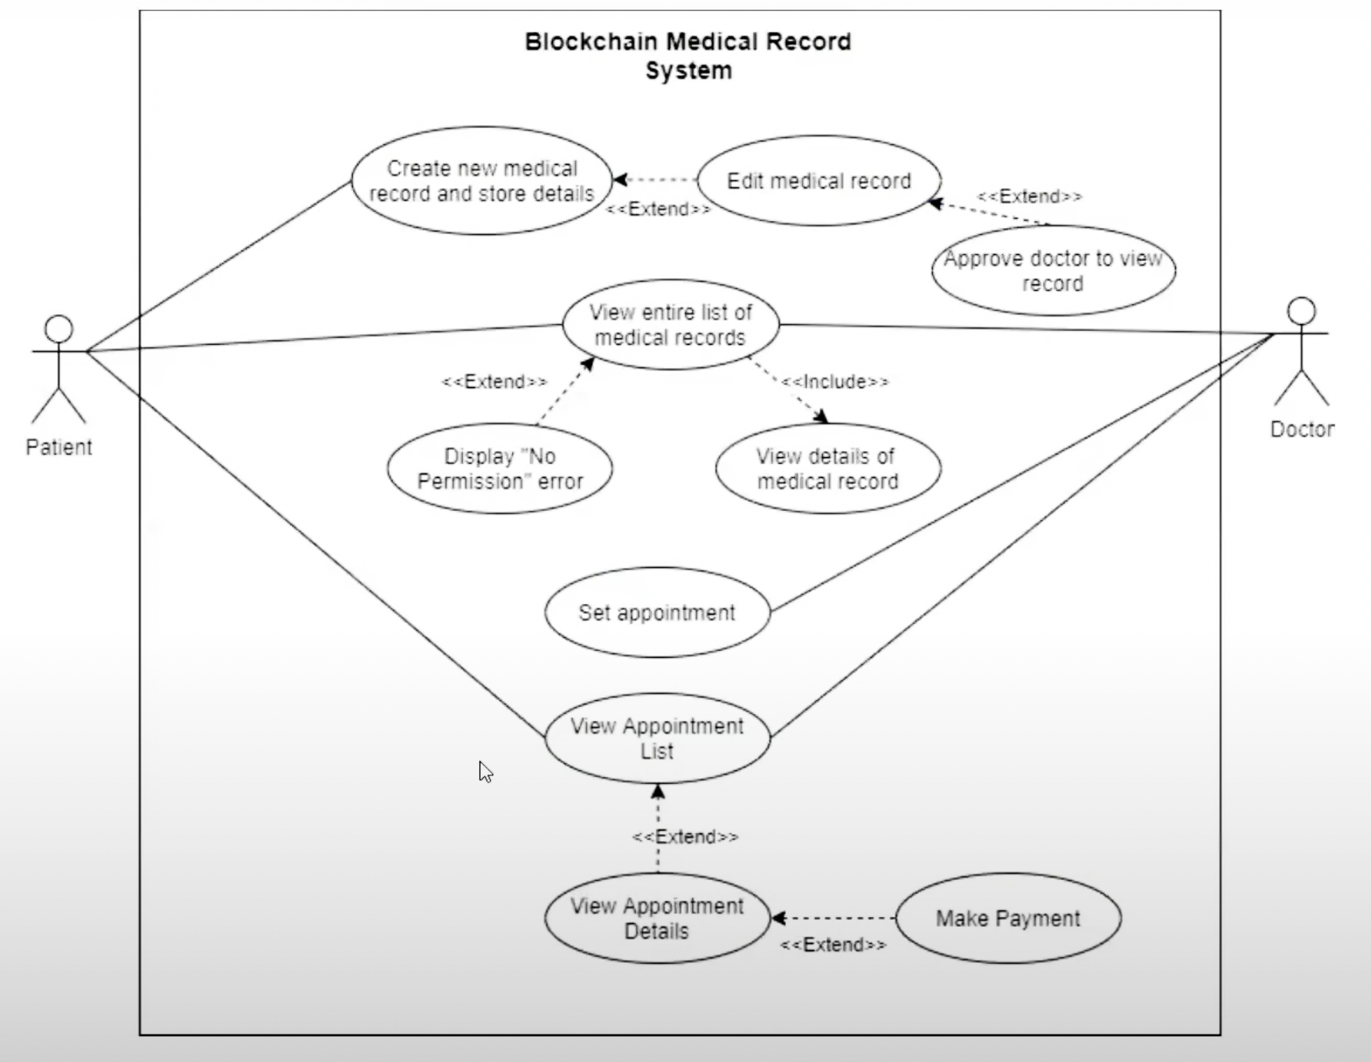
Use Case Diagram

Slide 18
05
Results

Slide 19
Results
Hospitals all around india and the world can use this medical record system
Successfully created a smart contract to manage electronic health records of patients
Successfully used blockchain to add an unprecedented layer of security. Ethereum network has been used
There is no compromise done regarding security and this system can be used for day to day operations of hospitals

Slide 20
06
Conclusion and Future Scope

Slide 21
Conclusion
Successfully created a blockchain based Electronic health record

Slide 22
Future Scope
Storing Documents
User Interfaces
Payment Feature
The current system doesn’t allow medical images and pdf files to be stored
To implement this feature IPFS technology must be used
The system would be deployed on a website using HTML,CSS and JS
Front-end frameworks in the future that accommodate for blockchain systems
Payment Feature will consist of printing and storing invoices
This will make this system a one stop solution for everything

Slide 23
Thank You

